Slide 1
Car Evaluation
Milestone project
ARUN | DATA ANALYSITICS & DATA SCIENCE| JULY BATCH ,COHORT C

Slide 2
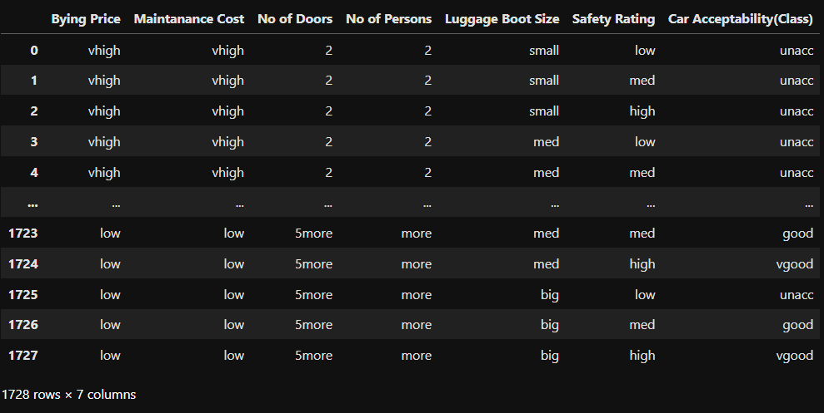
Dataset Overview
The dataset contains car evaluation details including attributes such as Buying Price, Maintenance Cost, Number of Doors, Passenger Capacity, Boot Space, and Safety Rating.
It includes 1,728 rows and 7 columns, categorized to assess car acceptability levels.
In this project, we focus on analyzing factors like price, safety, and capacity to understand how they influence the overall car acceptance (class).
Based on this analysis, insights can help manufacturers or consumers evaluate which features lead to higher car acceptance.

Slide 3
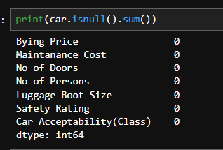
Finding Null Values
The dataset contains no missing values across all columns.
Data quality is strong, which means no imputation or cleaning is required for null values.
This ensures a smooth analysis and reliable modeling, since every record is complete.

Slide 4
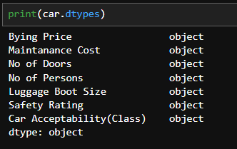
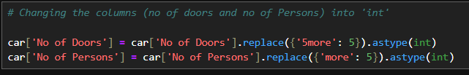
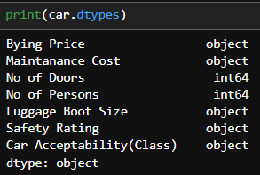
Finding Data Types
The fields ‘Number of Doors’ and ‘Number of Persons’ are stored as categorical (object) data types. To enable proper numerical analysis, these attributes need to be converted into integer format.
We replaced “5more” with 5 and converted both columns into integers to make them usable for analysis
Now, ‘Number of Doors’ and ‘Number of Persons’ are converted to integers for proper analysis.

Slide 5
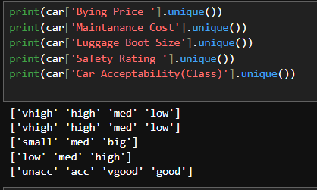
Encoding
here , Buying price, maintenance cost, boot size, safety rating, and car acceptability are categorical features, so they need to be converted into numeric values for analysis.
These columns contain categorical values and must be encoded into numeric format
These fields are categorical, so we convert them into numbers for processing.

Slide 6
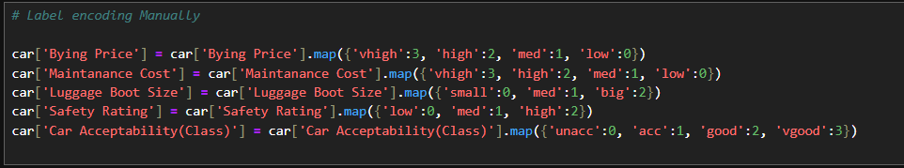
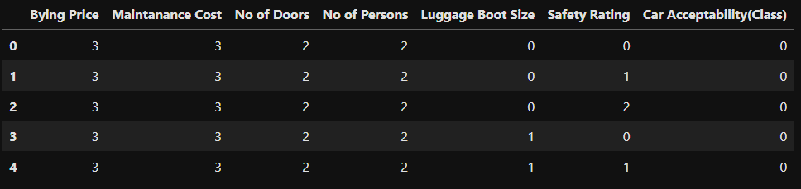
Label Encoding manually
We manually encoded the categorical columns by mapping each category to a numerical value, allowing the data to be used in analysis .
After encoding, all categorical columns have been successfully converted into numeric values, and the dataset is now ready for further analysis and modeling

Slide 7

Converting Target Variable to 0 and 1
Changing the target to 0 and 1 makes it easier for the model to understand
Binary values make the target cleaner and easier to process

Slide 8
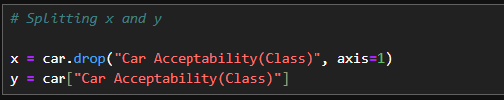
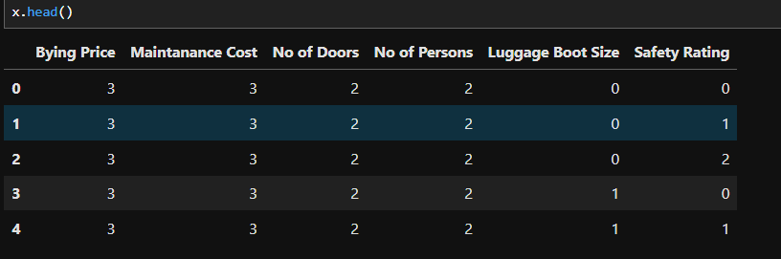
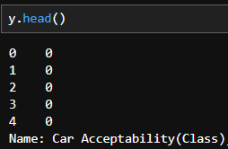
Splitting features and target
The independent variables were separated as X, and the target variable was assigned to y, enabling us to train and evaluate the model effectively

Slide 9
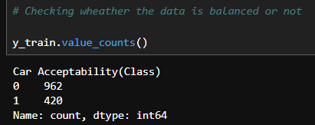
Train – test split
We split the data into train and test sets (80–20) to train the model and check its accuracy.
Checking class balance
The training data is imbalanced, with class 0 having more samples than class 1
Class 0 has 962 records, while class 1 has 420 records.
This imbalance may affect model performance, so techniques like resampling or class weighting might be required.

Slide 10
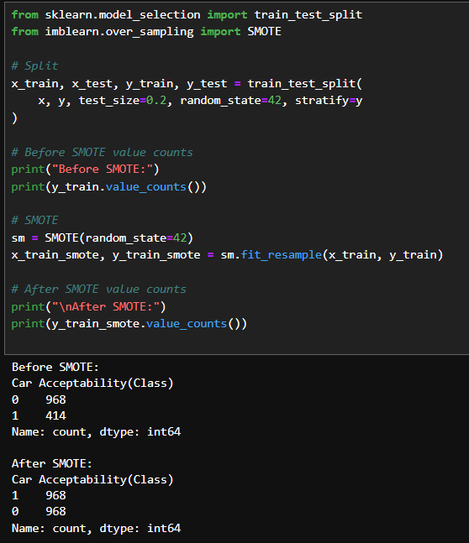
Balancing data using smote
The dataset was imbalanced with 968 samples in class 0 and 414 samples in class 1
SMOTE balanced the classes by creating equal samples for both categories
After applying SMOTE, the dataset became balanced, helping the model learn better
SMOTE fixed the imbalance by adding more minority class records

Slide 11
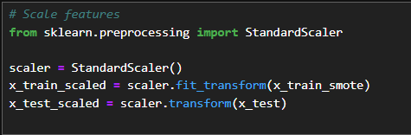
Feature scaling using standardscaler
Here, I used StandardScaler to scale the features before training the model

Slide 12
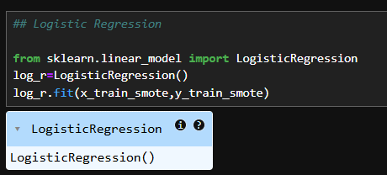
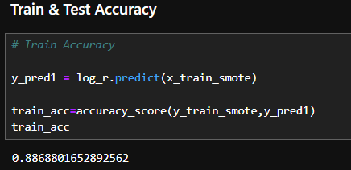
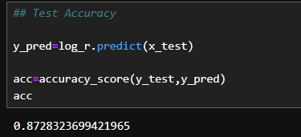
Logistic regression
Logistic Regression was trained on the balanced data to predict car acceptability.
Train and test accuracy

Slide 13
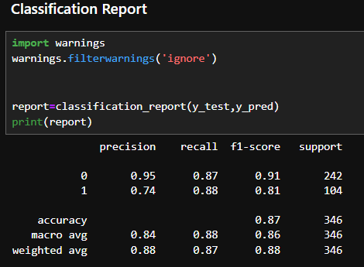
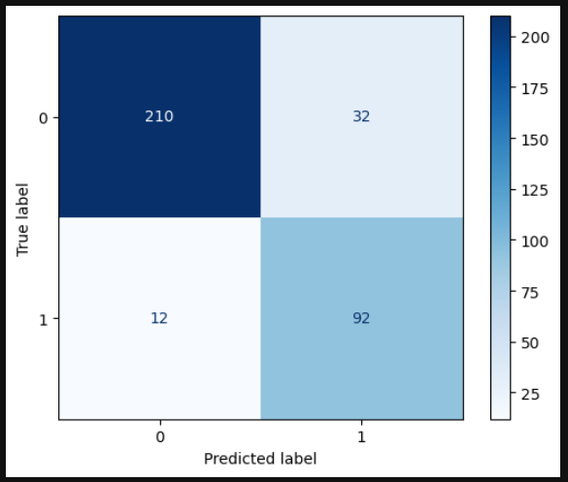
Classification report
Confusion matrix

Slide 14
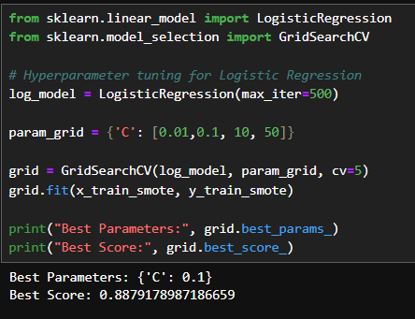
Hyperparameter tuning
The best value for Logistic Regression was C = 0.1.
This gave the best accuracy of about 88%.
The tuned model works well for this dataset.

Slide 15
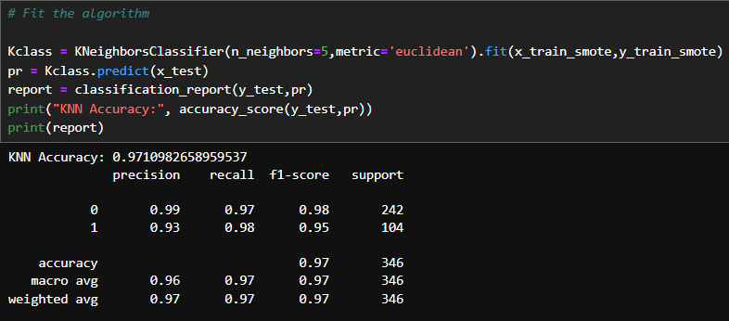
K-nearest neighbors
The KNN classifier achieved a high accuracy of 97%, showing strong prediction performance.
Both classes were classified well with high precision, recall, and F1 scores.
The balanced performance across metrics indicates that the model generalizes well on unseen data.

Slide 16
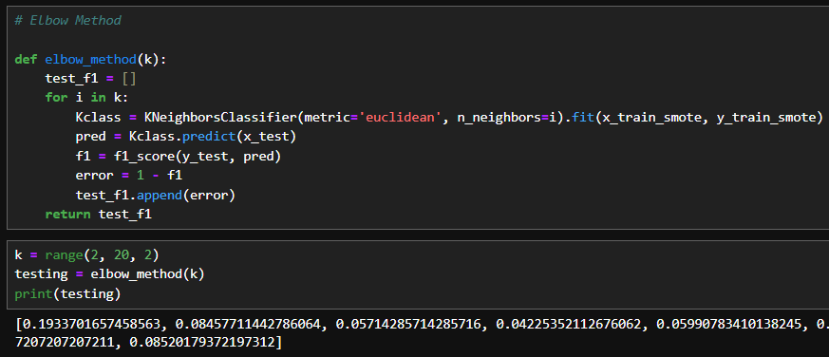
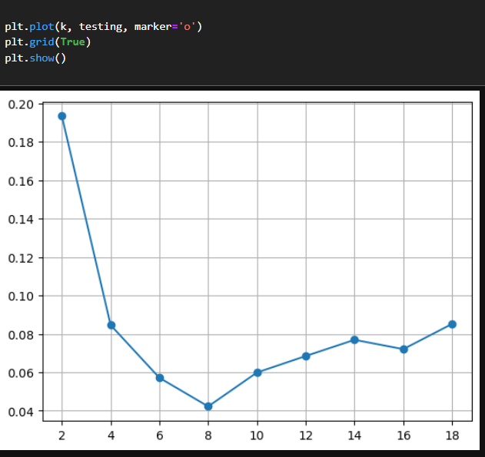
Elbow method
The error is lowest around K = 8, so it is the best choice for KNN

Slide 17
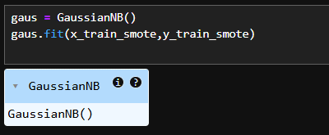
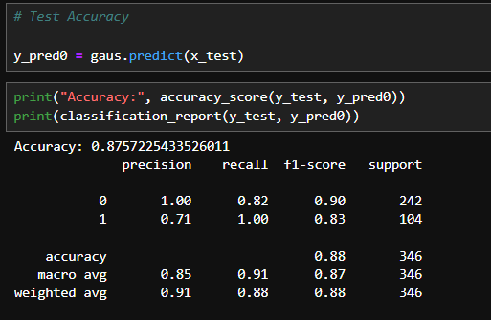
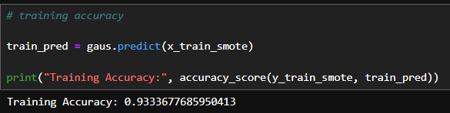
Naïve byes
Gaussian Naive Bayes was trained on the balanced dataset to perform classification
Train and test accuracy

Slide 18
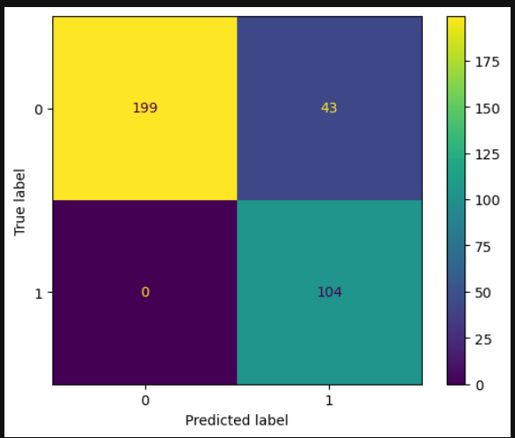
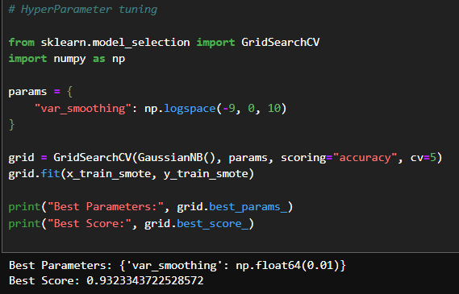
Confusion matrix
Hyperparameter tuning
GridSearchCV found the best parameter (var_smoothing = 0.01) and improved the model accuracy to about 93%.

Slide 19
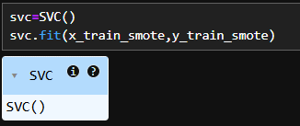
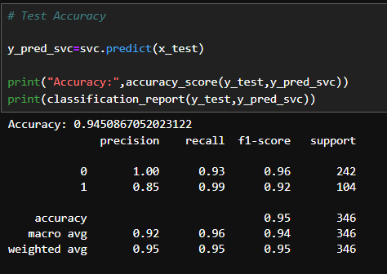
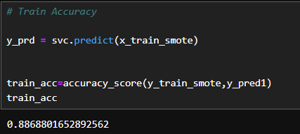
Svm (support vector machine)
Support Vector Classifier (SVC) was trained on the balanced dataset to classify car acceptability.
Train and test accuracy
The model got 88% accuracy on training data and 94.5% accuracy on test data
This means the model learns well and works even better on unseen data

Slide 20
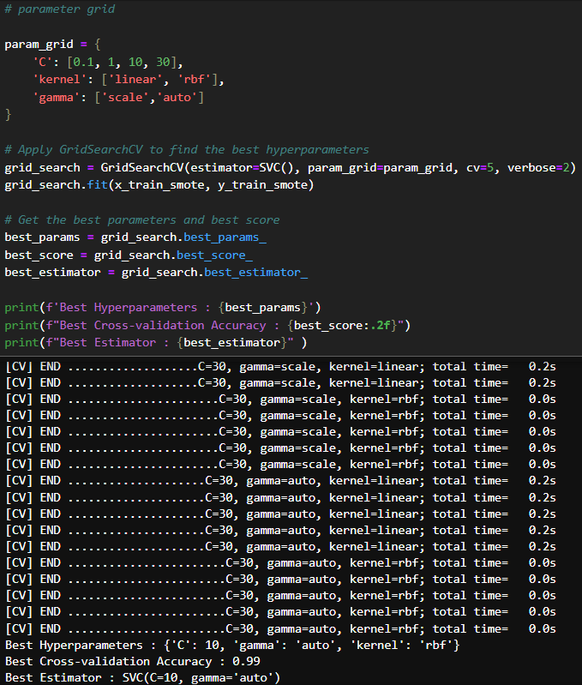
Hyperparameter tuning
GridSearchCV helped find the best SVM settings.- The best combination was C = 10, Kernel = RBF, Gamma = Auto.
This setup gave 99% accuracy.- The RBF kernel worked best because the data needs a flexible boundary.
A higher C value helped the model make fewer mistakes.
Overall, the tuned SVM model performs very well for this classification task.

Slide 21
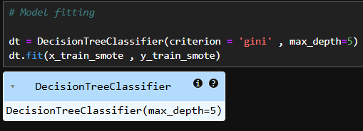
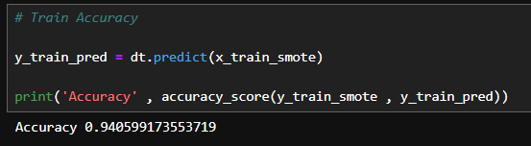
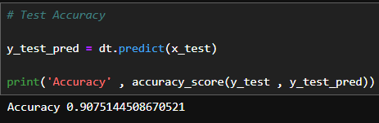
Decision tree
A Decision Tree classifier was trained using the balanced dataset to learn decision rules for predicting car acceptability
Train and test accuracy

Slide 22
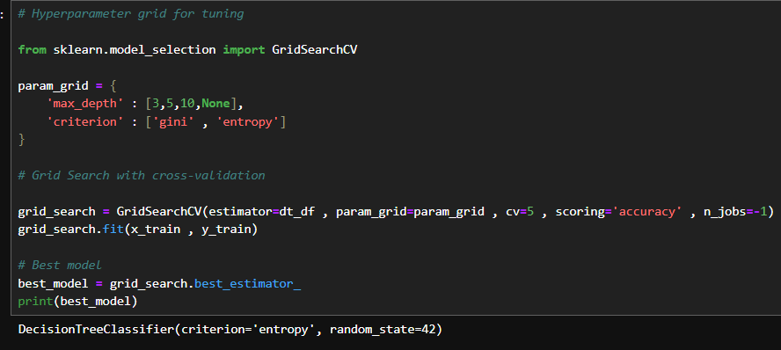
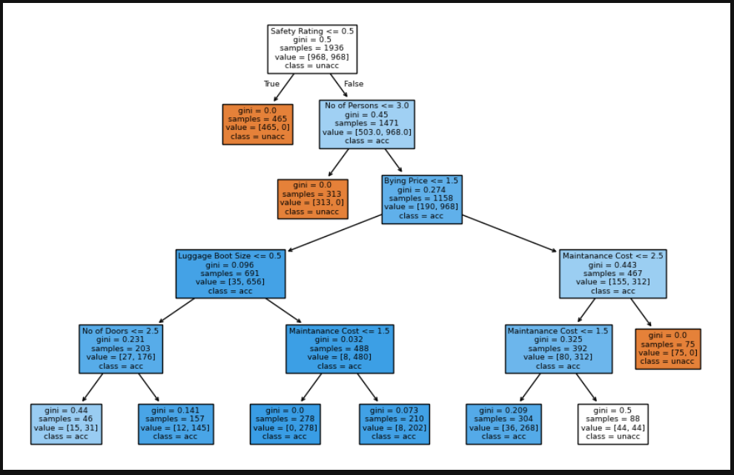
Hyperparameter tuning
Decision tree plot
We applied GridSearchCV to find the best depth and criterion for the Decision Tree.
The tuning selected the best model with entropy criterion.

Slide 23
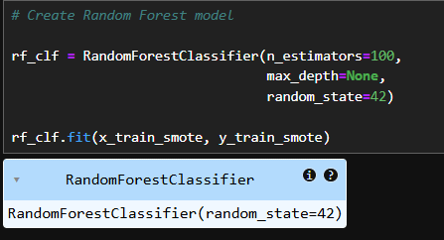
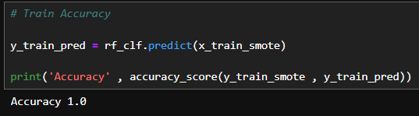
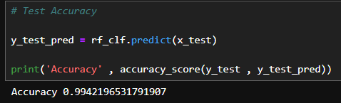
Random forest
We fitted a Random Forest model on the balanced data to enhance performance and reduce overfitting.
Train and test accuracy

Slide 24
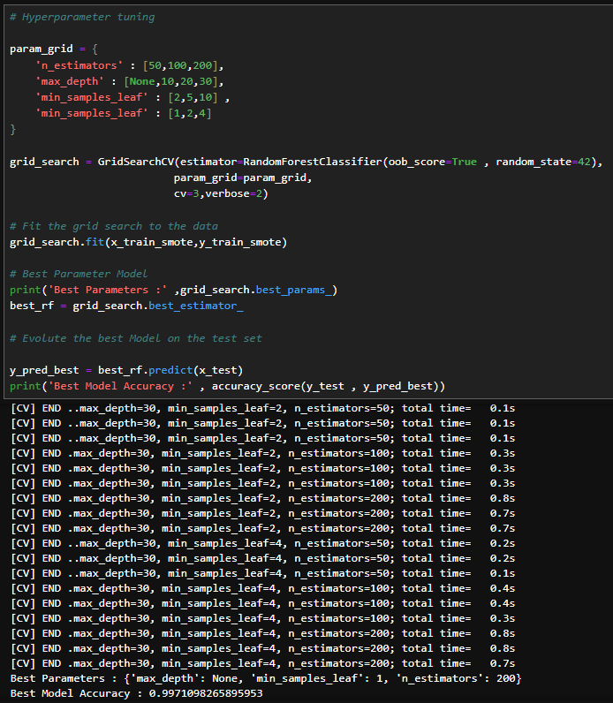

Hyperparameter tuning
AdaBoost, Gradient Boosting, and XGBoost are boosting algorithms that improve weak models by combining them.
They help increase accuracy by learning from previous mistakes.
In our case, Random Forest already performed extremely well, so using boosting models was optional.

Slide 25
conclusion
In this project, multiple machine learning models were applied to classify car acceptability.
After comparing model performances, Random Forest emerged as the most accurate model, achieving nearly perfect results.
The feature importance analysis showed that Safety Rating and Number of Persons play a major role in decision-making.
Overall, the project shows that machine learning can successfully analyse car evaluation data and provide reliable predictions.

Slide 26
Thank you

